Slide 1

Supply Chain Optimization under Trade War
An illustrated example for iPhone XS Max
Group 12
Utkarsh Chaturvedi
Jiang Yi Ching
Lu Zhi Hao
Michael Li Qing Lei

Slide 2
Agenda
01
Problem Motivations
02
Background and Approach
03
Optimization Formulation
04
Preliminary results

Slide 3
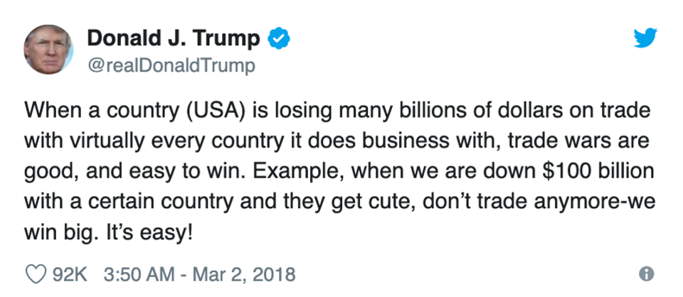

Slide 4


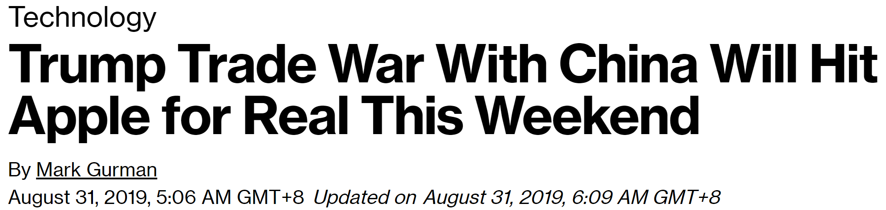
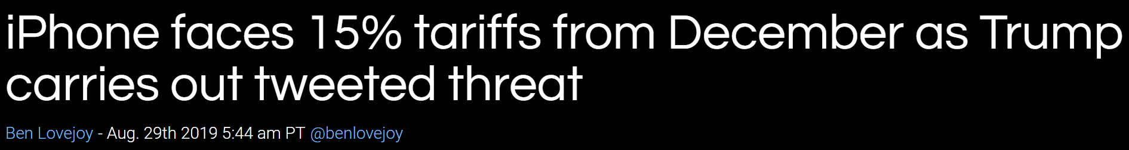

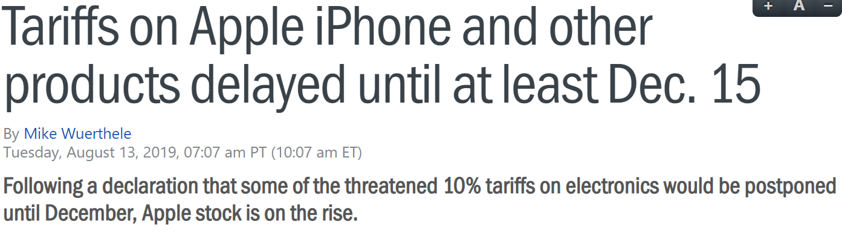
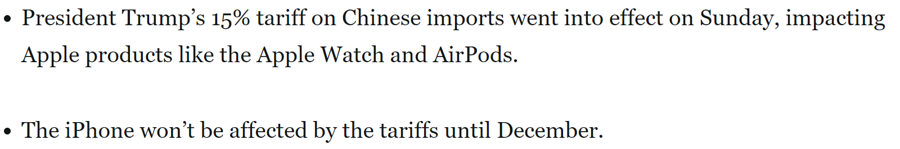
Apple to become the latest target of the trade war with sanctions on iPhone scheduled on Dec. 15

Slide 5

Simplified version of iPhone’s Supply Chain Network
Sample iPhone: iPhone XS Max
Problem Scope:
Focus on US customers which would be impacted by additional tariffs.
3 Foxconn assembly plants located in China, India, Brazil.
16 Suppliers to support components to these 3 factories.
Assembly plants
Supplier locations

Slide 6
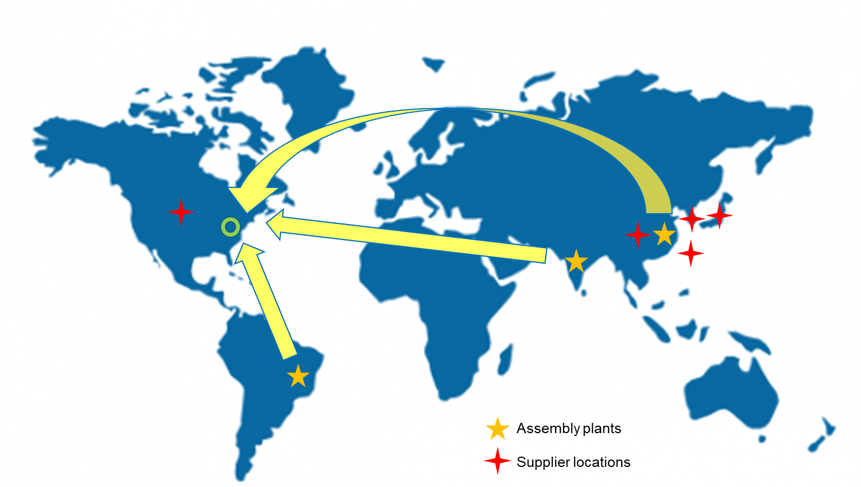
Apple would want to optimize the amount of iPhones assembled & dispatched from each country

Slide 7
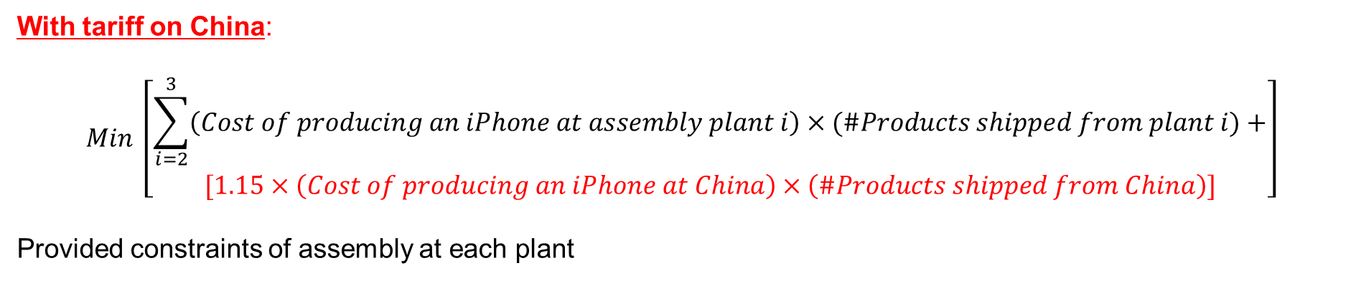
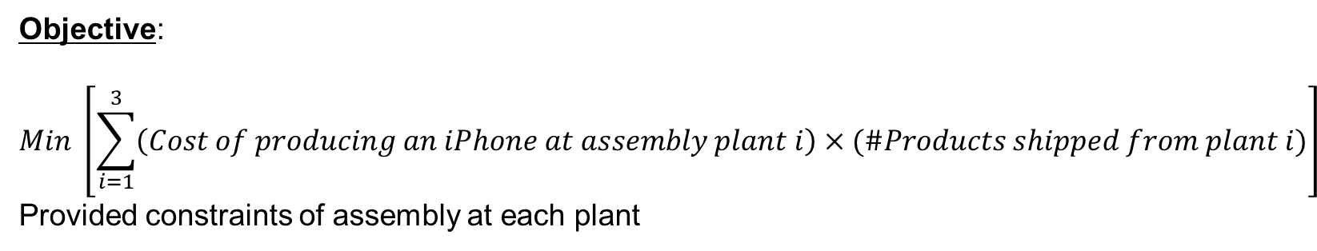
But this optimization is not a linear problem
Objective:
$$Min \left[\sum_{i=1}^{3}{\left(Cost of producing an iPhone at assembly plant i\right)×(\#Products shipped from plant i)}\right]$$
Provided constraints of assembly at each plant
With tariff on China:
$$Min \left[\begin{aligned}\sum_{i=2}^{3}{\left(Cost of producing an iPhone at assembly plant i\right)×(\#Products shipped from plant i)}+ \\ [1.15×\left(Cost of producing an iPhone at China\right)×\left(\#Products shipped from China\right)]\end{aligned}\right]$$
Provided constraints of assembly at each plant

Slide 8
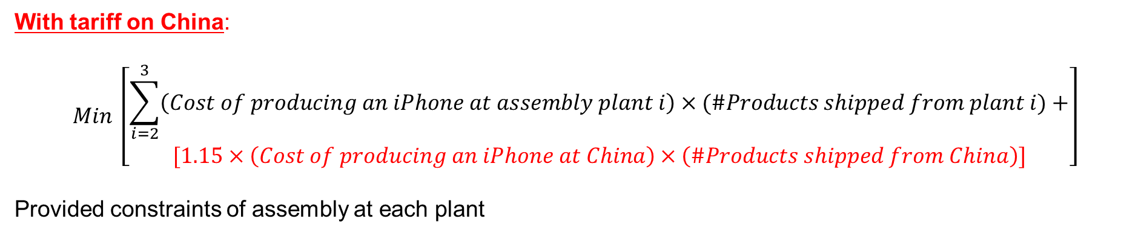
Due to shock through the entire system, cost of production is no longer a parameter
With tariff on China:
$$Min \left[\begin{aligned}\sum_{i=2}^{3}{\left(Cost of producing an iPhone at assembly plant i\right)×(\#Products shipped from plant i)}+ \\ [1.15×\left(Cost of producing an iPhone at China\right)×\left(\#Products shipped from China\right)]\end{aligned}\right]$$
Provided constraints of assembly at each plant
Why is not an LP?
The cost of producing an iPhone now depends on the number of phones that can be shipped from the assembly plant at lowest possible cost
But, lowest possible cost of production depends on how many products is Apple willing to assemble and ship from a particular plant

Slide 9
Assumption: Supplier quantity is no longer a constraint on the assembly
Implications:
Legitimizes a greedy approach to cost of production i.e. the cheapest possible combination of suppliers for a plant are also the optimal combination of suppliers for lowering the cost of production of iPhone across 3 plants
Allows the problem to become an integer problem

Slide 10
Phase 1: Minimize Supply Chain Cost
Objective:
Minimize Supply Chain Cost once additional tariffs applied for CN to US.
Simplified Supply Chain Cost:
Components landed cost + assembly cost + Duty when applicable
Assumptions:
8 components from 16 suppliers
Each component supplies from 2 suppliers with different Component landed cost.
3 assembly plants located at China, India & Brazil
10% Raw Material Import duty to India
15% Finished Goods Import duty from China to US
Different assembly cost at 3 factories

Slide 11

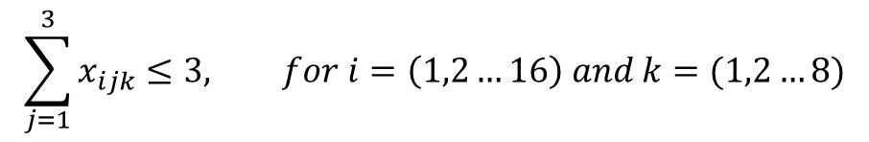
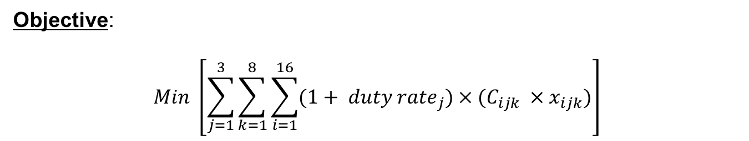
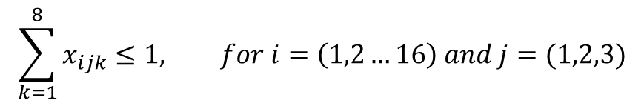
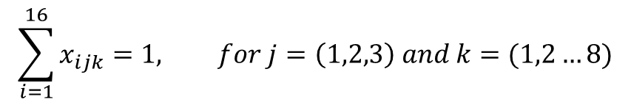
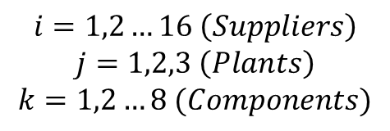
Phase 1: Formulation
Objective:
$$Min \left[\sum_{j=1}^{3}{\sum_{k=1}^{8}{\sum_{i=1}^{16}{(1+ {duty rate}_{j})×(C_{ijk} ×x_{ijk})}}}\right]$$
$$i=1,2…16 \left(Suppliers\right)$$
$$j=1,2,3 \left(Plants\right)$$
$$k=1,2…8 (Components)$$
Decision Variables:
Constraints:
$$x_{ijk}∈\left\{0,1\right\}$$
$$\sum_{i=1}^{16}{x_{ijk}}=1, for j=\left(1,2,3\right) and k=(1,2…8)$$
1.
Only 1 supplier for 1 component to 1 plant
$$\sum_{k=1}^{8}{x_{ijk}}≤1, for i=\left(1,2…16\right) and j=(1,2,3)$$
2.
Max. 1 component supplied from 1 supplier to 1 plant
$$\sum_{j=1}^{3}{x_{ijk}}≤3, for i=\left(1,2…16\right) and k=(1,2…8)$$
Component can be supplied by 1 supplier to max of 3 assembly plants
3.

Slide 12
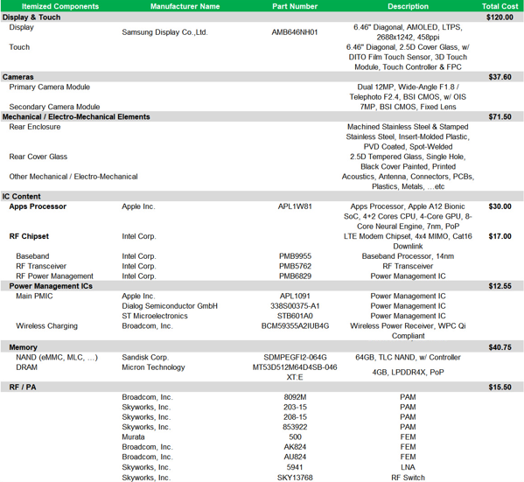
Data Collection
Component Landed cost at 3 assembly plants
Logistics Cost from assembly plants to US customers
Origin | Dest | Rate (US$/kg) | Unit Cost (US$/unit)
China | US | 2.9 | 2.9
India | US | 3.3 | 3.3
Brazil | US | 1.8 | 1.8
* Assuming iPhone is 1kg with packaging
Assembly cost for 3 factories
China: $ 24.5 /unit
India: $ 12 /unit
Brazil: $ 26.5 /unit

Slide 13
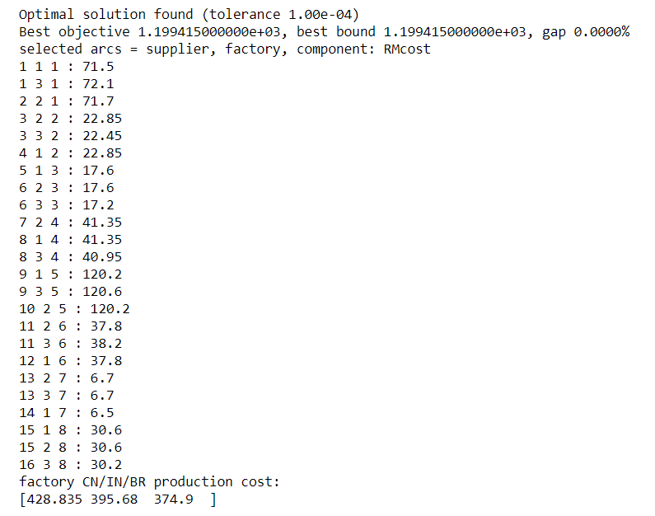
Phase 1 preliminary result
The arcs selected for optimal solution on
(i, j, k) = (supplier, factory, component)
And the 3 factories final production cost considering the additional tariffs impact.

Slide 14
Phase 2: Maximize Profit to US market
Objective:
Maximize the profit for iPhone sell in US.
Profit =
(Retail Price * Quantity)
– Sum [1.15*(Production cost of China * Quantity from China) + Logistics Cost from China
+ (Production cost elsewhere * Quantity from elsewhere) + Logistics Cost from elsewhere]
Assumptions:
Optimized production cost is from Phase 1 result
Avg. Customer demand = 1145 k units/month
Factory capacity in ‘k units/month
China: 800
India: 360
Brazil: 120
Retail price of iPhone: $1000

Slide 15
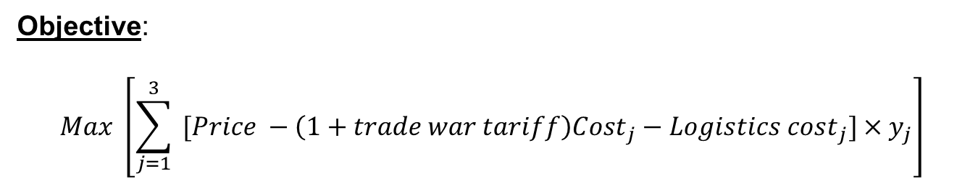

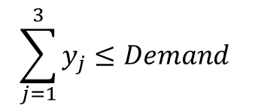
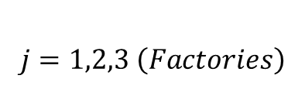
Phase 2: Formulation
Objective:
$$Max \left[\sum_{j=1}^{3}{ [Price −{\left(1+trade war tariff\right)Cost}_{j}−{Logistics cost}_{j}]×y_{j}}\right]$$
$$j=1,2,3 \left(Factories\right)$$
Decision Variables:
Constraints:
$$y_{j}, quantity shipped from each factory (non−negative)$$
$$\sum_{j=1}^{3}{y_{j}}≤Demand$$
1.
Sum of quantity less than or equal to demand
2.
$${0≤y}_{j}≤{Capacity}_{j}$$
Each factory produces quantity less or equal to its capacity

Slide 16
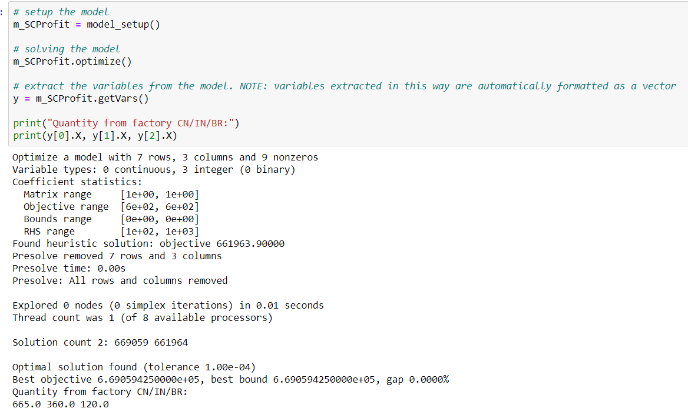
Phase 2 preliminary result
The best profit with the quantity from 3 factories.
Both IN and BR factory reaches their maximum capacity, there is potential opportunity to invest on more capacity in these 2 factories.

Slide 17
Thank You

Slide 18
Approach of evolving the model to be more realistic
Phase 1: Minimize Supply Chain Cost
Phase 2: Maximize Profit
Prototype testing of 4 Components, 8 Suppliers, Component cost only.
Test model to prove it works fine to identify the right Arcs
Phase 1 Result interpretation
Interpret the model optimization results and provide business suggestions
Real data collection
Extend to complete model by including 8 components/16 suppliers, duty, logistics cost
Phase 2:
Objective Max. Profit with outcome from Phase 1
Search real data with certain assumptions for iPhone XS Max; including components cost, suppliers, factories and Logistics cost
Explore shifting to Max. Profit Objective by incorporate US customers demand, factory capacity constrains

Slide 19
Simplified version of iPhone’s Supply Chain Network
Sample iPhone: iPhone XS Max
Problem Scope:
Focus on US customers which would be impacted by additional tariffs.
3 Assembly plants located in China, India, Brazil.
16 Suppliers to support components to these 3 factories.
Assembly plants
Supplier locations

Slide 20
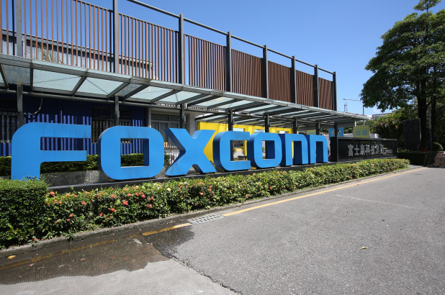
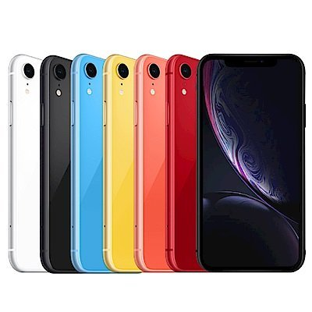
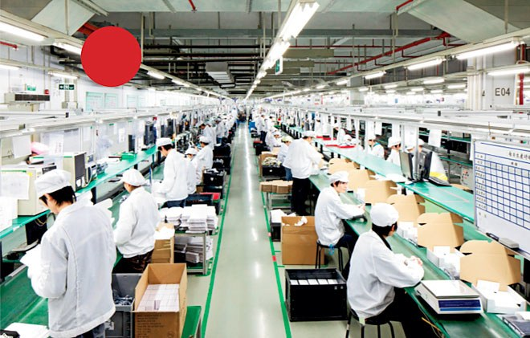

Slide 21
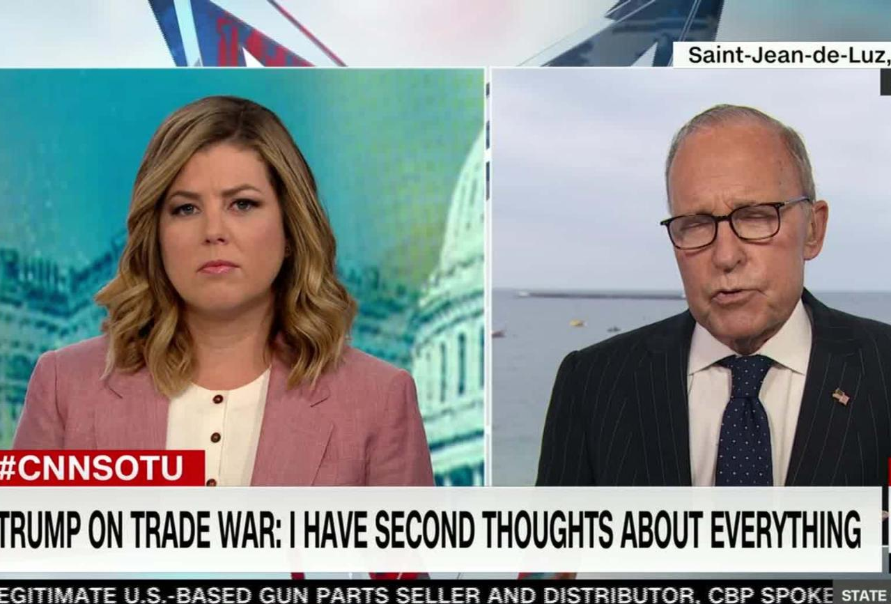
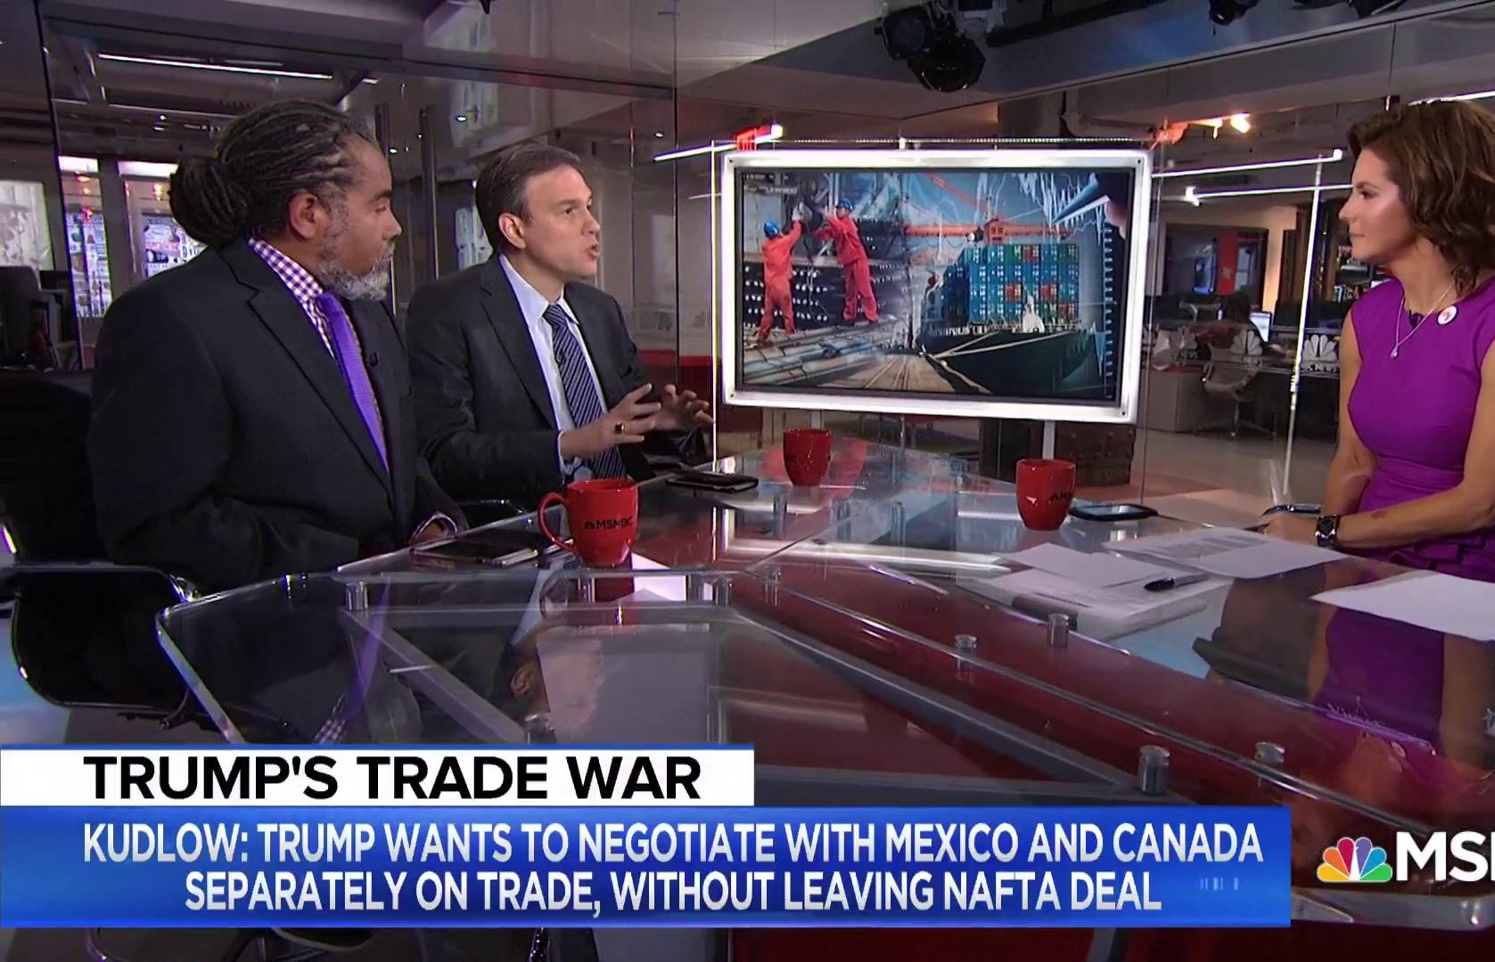
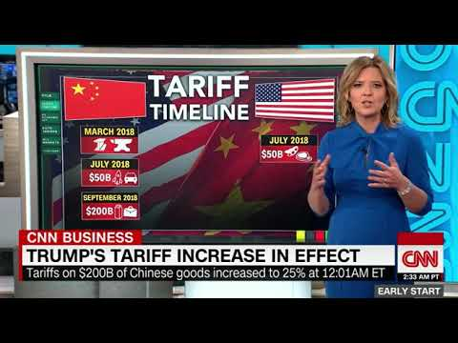
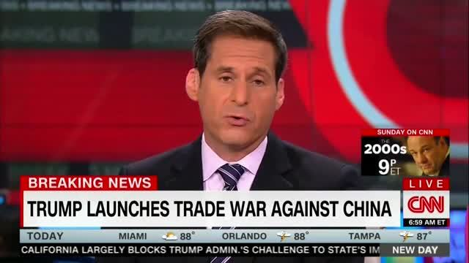

Slide 22
1
2
Components
Supplier
1
2
3
4
Supplier cost
$10
$11
$20
$21
?
?
Assembly cost
Decision: $33(??)
Decision:$32 (??)
Assembly capacity
Plant 1: 200
Plant 2: 90
Total Demand: 250

